Slide 1






X
ETL for Bank BTPN
Syariah Credit Card
Customer
BTPN Syariah - Data Engineer
Presented by
Gilang Wiradhyaksa

Slide 2





Gilang Wiradhyaksa
Data Engineer
I am a Fullstack Software Developer transitioning to Data Science. Experienced in building a Web Application, API Web Service and Background Service.
Possess an understanding of statistical analysis, machine learning, and data visualization techniques, combined with strong programming skills in Python and proficiency in SQL.
My experience includes data preprocessing, feature engineering and model development.
Surabaya, Indonesia
gilang.wirad@gmail.com
in/gilangwiradhyaksa/

Slide 3
Courses and Certification
Hacktiv8 / Data Science | Certificate November, 2023
Inixindo / Android Studio - Basic | Certificate March, 2018

Slide 4

About Company
Since its inception as Sharia Business Unit of PT Bank Tabungan Pensiunan Nasional Tbk in 2010, BTPN Syariah has included and reached the segment that had not been touched by banking sector, that is the inclusive communities segment.
With the mandate to deliver empowerment activities and financial literacy for the women in the country, BTPN Syariah provides access and banking products and services in Sharia principles for them to affirm the intention to realize the aspiration for a better life.
On 14 July 2014, BTPN Syariah was officially registered as the 12th Sharia Commercial Bank in Indonesia by the spin off PT Bank Tabungan Pensiunan Nasional Tbk’s Sharia Business Unit and the conversion of PT Bank Sahabat Purna Danarta (“BSPD”).

Slide 5
Project Portfolio
This project is an ETL (Extract Transform Load) project. The data contains Bank BTPN Syariah Credit Card customer. The project is designed to gather data from various sources, transform it into a consistent format suitable for analysis and then load it into a data warehouse or database for querying and reporting.
This ETL project perform a batch processing with scheduler for automation using Airflow. Starting from SSIS, extract data from CSV file then transform it and load it into database and another CSV file. Then run this SSIS package (dtsx file) using Apache Airflow scheduler through a bash command everyday at 5 AM.
Those process generate a clean data in CSV format, then this clean data is used to create visualization in Tableau. This visualization can help Data Analyst to get some insight and help management to reduce customer churn.
Project explanation video here!

Slide 6
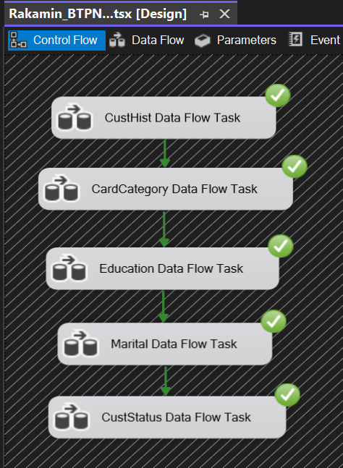
SQL Server Integration Services (SSIS)
Start from creating a new SSIS package using Microsoft Visual Studio.
Create a new Flat File Connection and choose Bank BTPN Syariah CSV file as sources.
Create five dataflow tasks with the provided data which is Customer History, Card Category, Education, Marital and Customer Status.

Slide 7
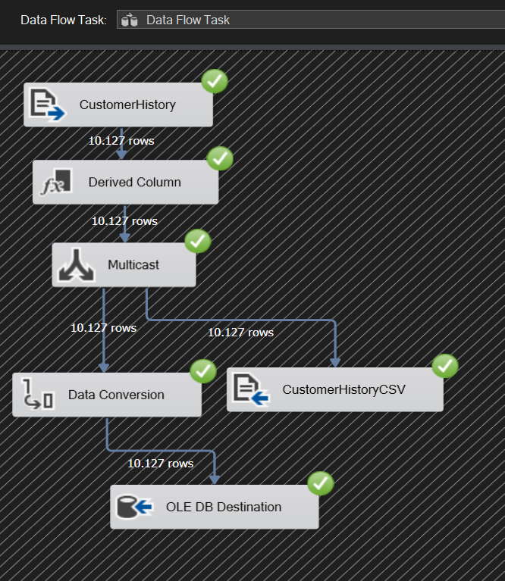
SSIS Package (.dtsx) here!
Inside the data flow task, create Flat File Sources to Extract Data. Choose data source from connection manager which has been created previously.
Begin the process of transforming data such as Derived Column, Data Type Conversion etc.
Split the process to two or more output. So it can be treated individually. In this case data conversion is only done for data that will be stored in the database.
Load the transformation result to CSV and Database simultaneously.

Slide 8
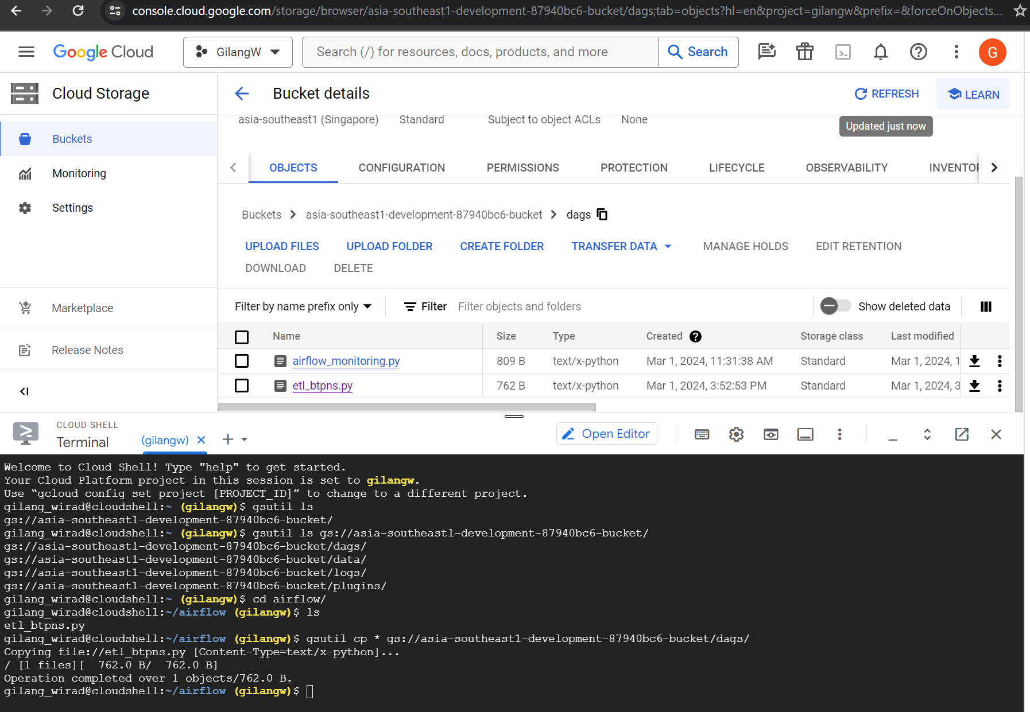
Creation of workflows on Apache Airflow
First create Airflow DAG in GCP for scheduling and running bash command. After it done, deploying .py file to DAG folder so it can appear in Airflow Task.

Slide 9
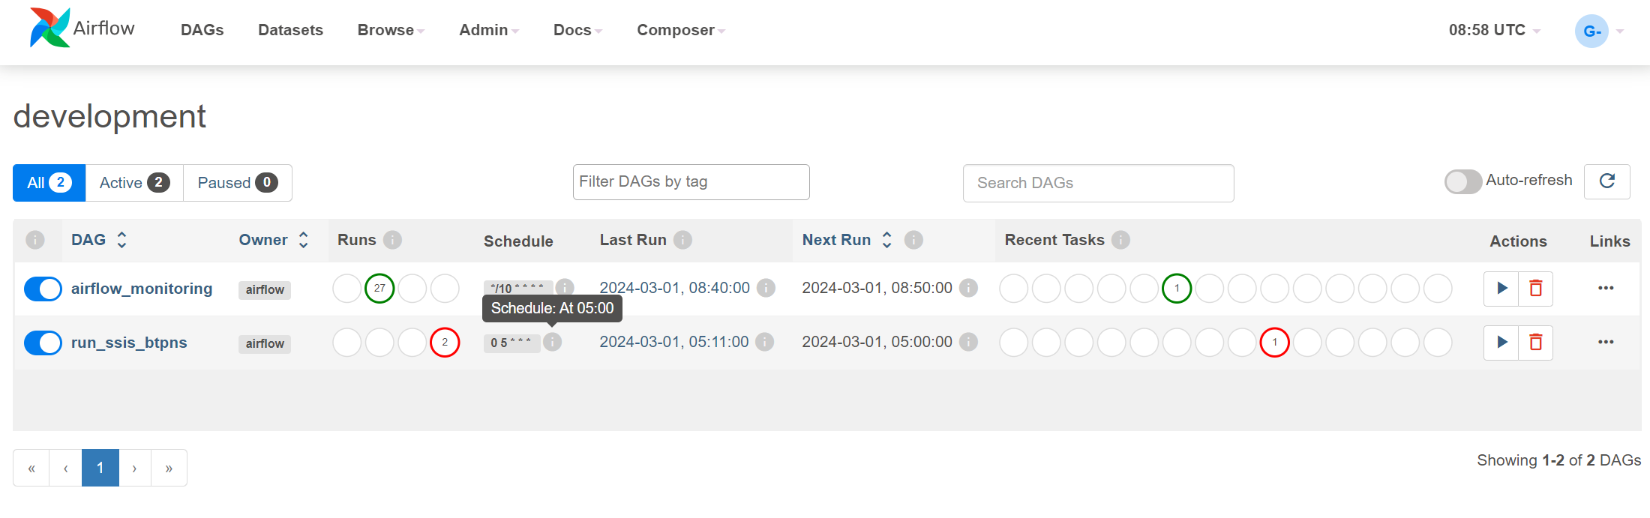
Apache Airflow DAGs (.py) here!
DAGs is appear in Airflow Task with the name “run_ssis_btpns” and scheduled to run everyday at 5 am

Slide 10
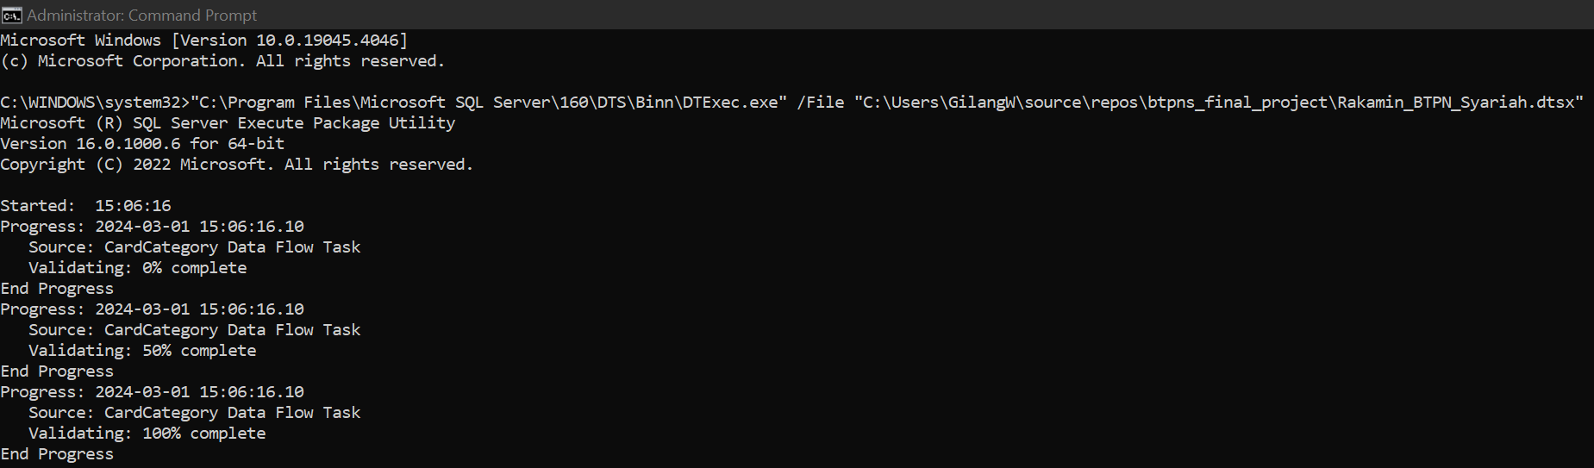
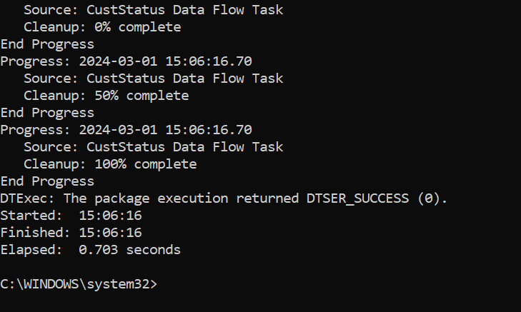
Apache Airflow DAGs (.py) here!
Bash command to run SSIS Package (dtsx file) that executed using Apache Airflow.
Result of SSIS Package that have been executed. The ETL process is done and produce clean data to be further used for data visualization in Tableau.

Slide 11
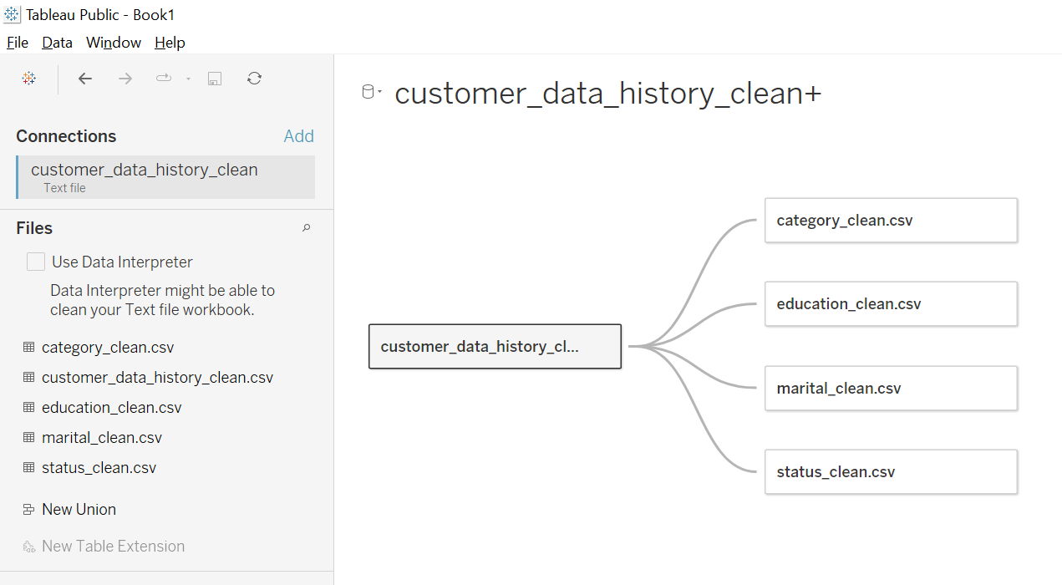
Creating Visualization with Tableau
Add Text File then choose CSV file that has been cleaned before. Repeat this step until all CSV file is loaded to Tableau.
Set a relation between CSV file. Choose the foreign key between data to create a relation.

Slide 12
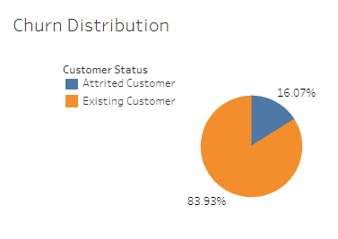
Tableau Dashboard here!
Churn Distribution
Churn Rate
Churn customer for BTPN Syariah Credit Card customer is at 16.07%.
Considered bad because according to forbes.com the normal churn rate is 5-7%.

Slide 13
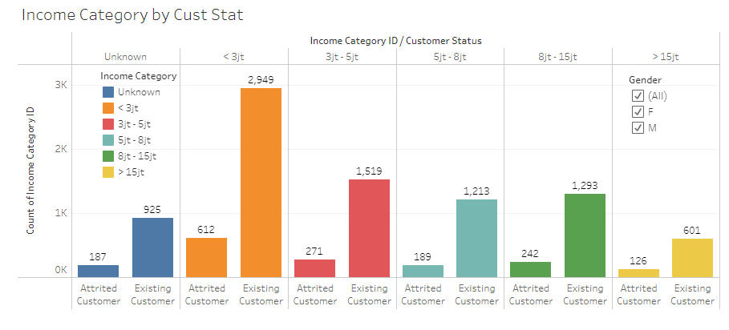
Tableau Dashboard here!
Income Category by Customer Churn
Income Category
Most of the credit card customer is in low-income category.
Most churn customer is came from customer with under 5m per month.

Slide 14
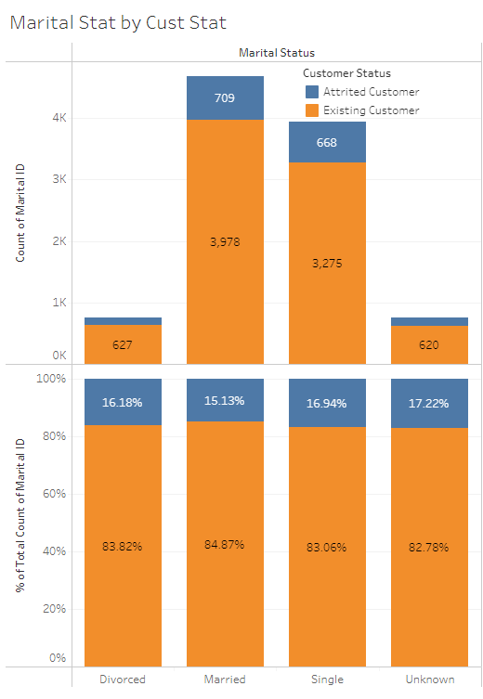
Tableau Dashboard here!
Marital Status by Customer Churn
Marital Status
Most of the Credit Card customer is Single and Married.
Percentage of customer churn in each status is about the same at 15-17%.

Slide 15
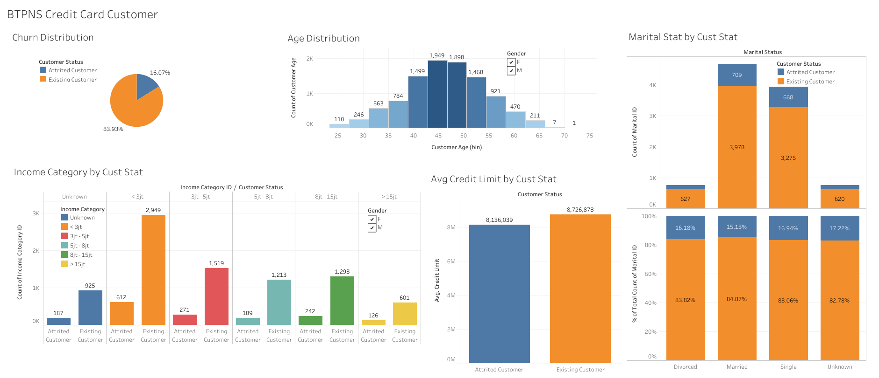
Tableau Dashboard here!

Slide 16
Conclusion
Based on the visualization we found that most of Bank BTPN Syariah Credit Card customer is came from people with income less than 5m per month.
Also their most customer age is between 40 to 55 years old.
The percentage of customer churn based on marital status is about the same. Means there is no correlation between churn and marital status.

Slide 17
Suggestion
For customer with high-income, giving a reward for using their credit card very often, so this customer will feel appreciated and respected. For high-income customer, appreciating them is more important rather than give them a discount or promotion.
Whilst for low-income customer can give them a promotion/discount for a relatively low-cost item if they use credit card to attract them for using their credit card more.
Do not make a promotion based on the marital status since there is no correlation between marital status and customer churn.
Invest in providing exceptional customer service experiences. Ensure that customer support is easily accessible, responsive, and empathetic. Train representatives to address customer concerns effectively and resolve issues promptly.

Slide 18
Project Result and Link
Presentation Project | Video
SSIS Package (.dtsx) | GitHub
Apache Airflow DAGs (.py) | GitHub
Tableau Dashboard | Tableau

Slide 19
Thank You
X

